Slide 1
Python File Handling

Slide 2
Python File Handling
Read File
Write/Delete File
Delete File

Slide 3
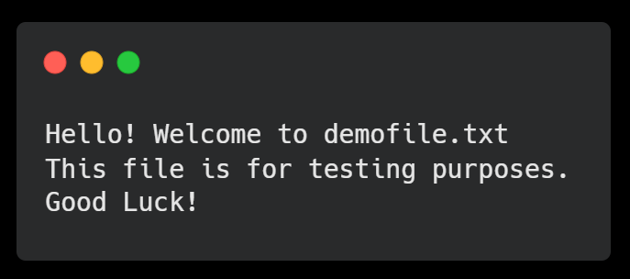
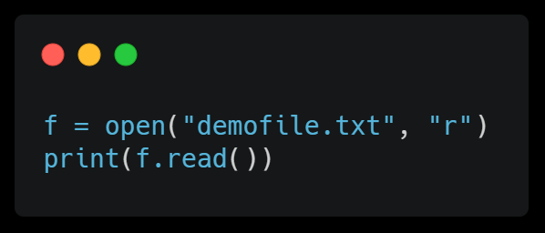
>> Python has several functions for creating, reading, updating and deleting files
Create a File demofile.txt
Open a File
To open the file, use the built-in open() function
The open() function returns a file object, which has a read() method for reading the content of the file

Slide 4
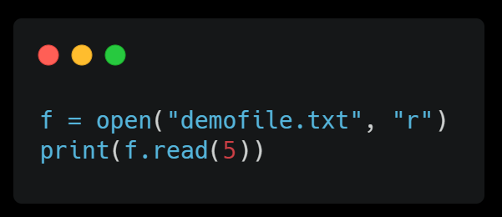
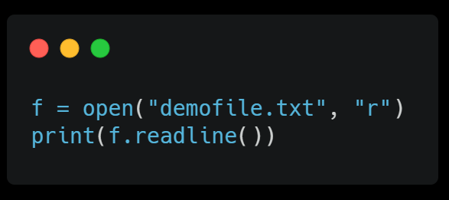
>> Read Only Parts of the File
2012
2015
2018
2020
2022
By default the read() method returns the whole text, but you can also specify how many characters you want to return
>> Read Lines
You can return one line by using the readline() method
By looping through the lines of the file, you can read the whole file, line by line

Slide 5
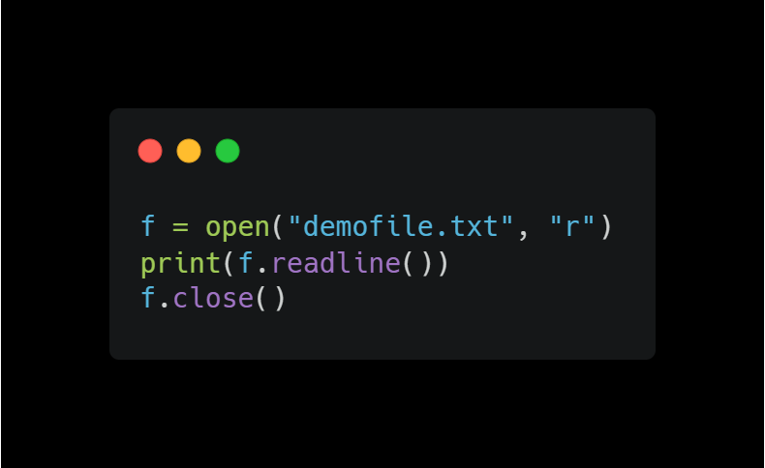
Close Files
It is a good practice to always close the file when you are done with it

Slide 6
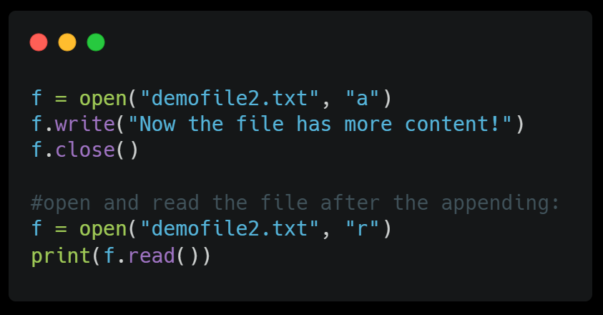
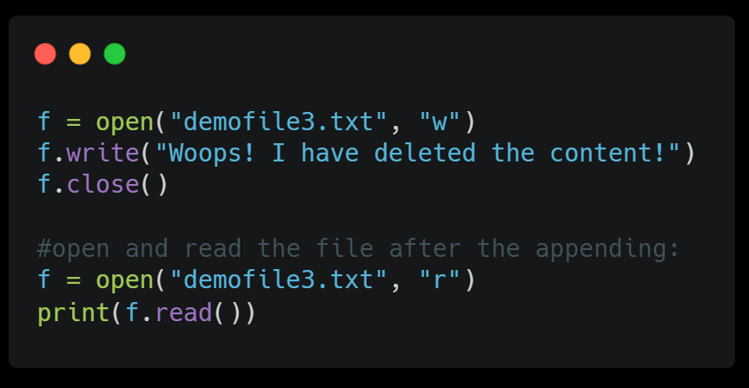
>> Write to an Existing File
2018
2022
To write to an existing file, you must add a parameter to the open() function:
"a" - Append - will append to the end of the file
"w" - Write - will overwrite any existing content
>> Open the file "demofile2.txt" and append content to the file
>> Open the file "demofile3.txt" and overwrite the content

Slide 7
>> Create a New File
2018
2022
To create a new file in Python, use the open() method, with one of the following parameters:
"x" - Create - will create a file, returns an error if the file exist
"a" - Append - will create a file if the specified file does not exist
"w" - Write - will create a file if the specified file does not exist

Slide 8
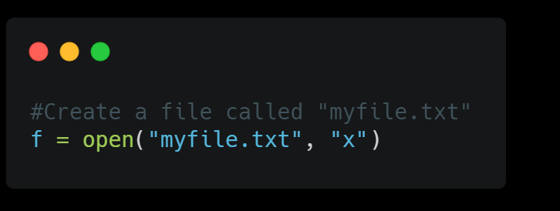
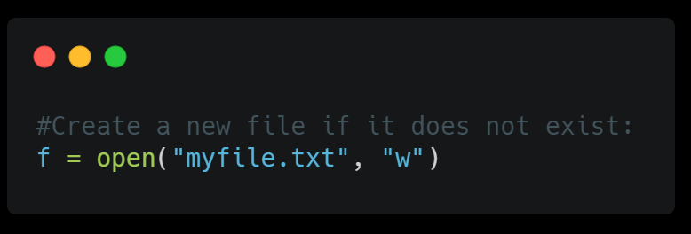
Create a New File

Slide 9
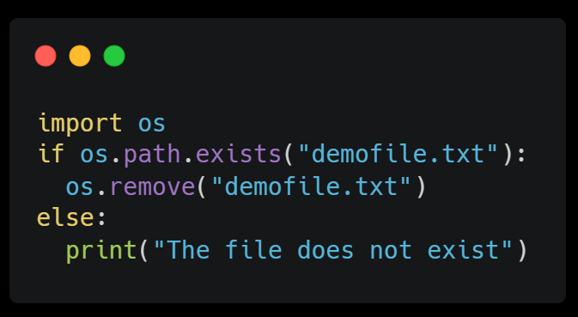
>> Python Delete File
To delete a file, you must import the OS module, and run its os.remove() function
import os
os.remove("demofile.txt")

Slide 10
THANKS
Do you have any questions?
kgn272000@gmail.com
+91 7020390678
Krishna Nimbalkar
Please keep this slide for attribution.

